Slide 1
Food Forecasting Analysis
Tableau Project
Abhishek V

Slide 2
Introduction
A meal delivery company that operates in multiple cities have various fulfilment centres in these cities for dispatching meal orders to their customers. The client wants to help these centres with demand forecasting for upcoming weeks so that these centres will plan the stock of raw materials accordingly.
Staffing of the centres is also one area wherein accurate demand forecasts are really helpful. We have the below information with us in the form of 3 different datasets:
Historical data of demand for a product-centre combination
Product (Meal) features such as category, sub-category, current price and discount
Information for fulfilment centres like centre area, city information, etc.
A story in Tableau that talks about the level of demand in each centre with proper granular analysis is to be prepared. An end-to-end report to understand which fulfilment areas are doing well and which aren't is to be submitted to the client. Centre-meal combinations can be used to add nuance to your final submission.

Slide 3
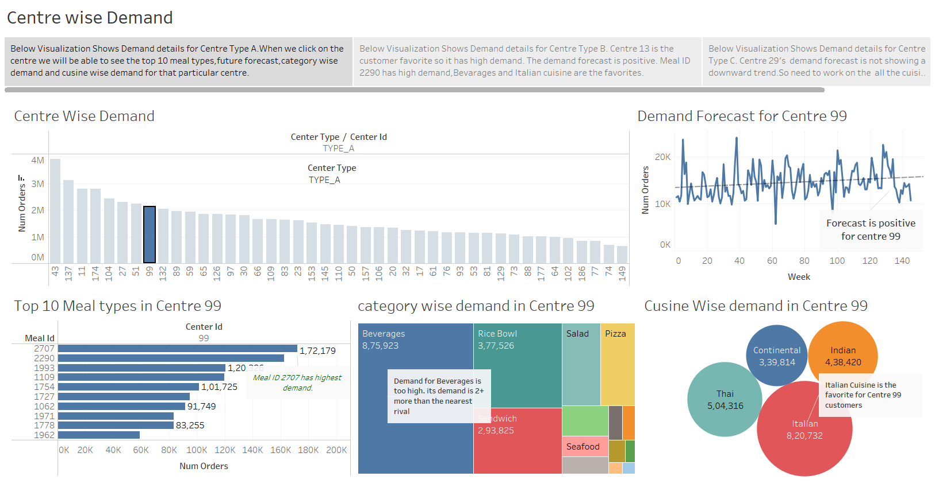

Slide 4
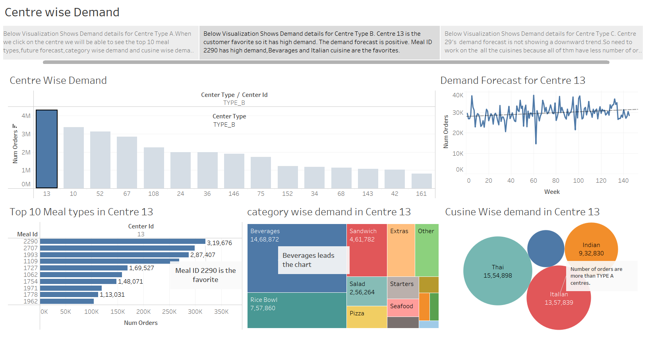

Slide 5
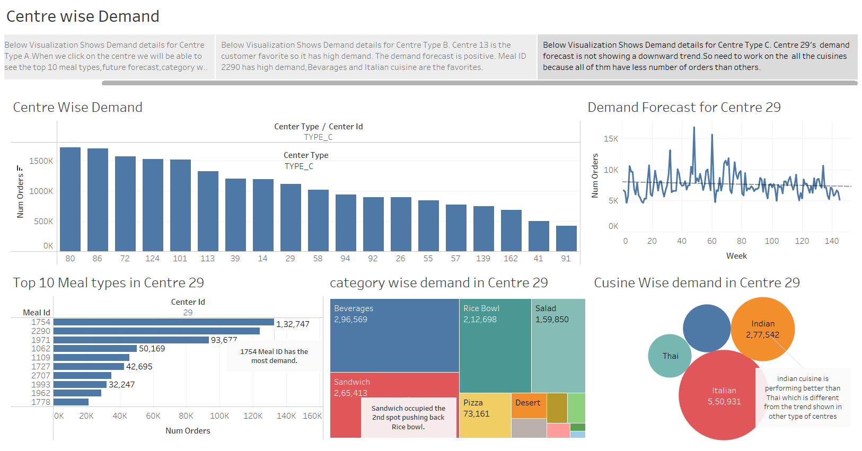

Slide 6
Conclusion
Demad for Beverages and Italian Cuisine are high so the raw materials has to be stocked accordingly.
Centre 13 of type B has the highest demand of all the fulfilment centres and the Meal ID 2290 is the customer favorite. So the raw materials for the Meal ID 2290 should be procured accordingly.
Centre 91 of type C has the lowest demand of all the fulfilment centres but the forecast for this centre is positive. So the raw materials for the top Meal ID’s of this centre like 1754,1971,1962 etc should be procured accordingly.
Staffing for these centres need to be adjusted according to the forecast because some centres like centre 91 which is a low performer is projected to be a race horse in the coming weeks.

